Slide 1
Inclusion in Art
Increasing participation in special area classrooms for students with autism
Rebecca Bertoch, Cheryl Stinson John G. Riley Elementary School
Leon County
Dawn Merrix
Florida State University CARD Center
Tallahassee, FL

Slide 2
Inclusion in Art
Purpose:
Students with autism were present, but not participating in special area classroom activities such as Media, Art, Music, Character Education, and P.E. The purpose of this project was to have students with autism from self-contained classrooms actively engaged in special area classes with their non-disabled peers.
Rebecca Bertoch, Cheryl Stinson John G. Riley Elementary School
Leon County
Dawn Merrix
Florida State University CARD Center
Tallahassee, FL

Slide 3
Inclusion in Art
Steps:
Set up training with FSU CARD partner and special area teachers
Meet with special area teachers – discuss routines, procedures, challenges, teacher priorities
Observe special area classrooms
Create and implement action plan
Track data; more observations
Rebecca Bertoch, Cheryl Stinson John G. Riley Elementary School
Leon County
Dawn Merrix
Florida State University CARD Center
Tallahassee, FL

Slide 4
Inclusion in Art
Process:
After the training, one special area was identified for additional support. The art teacher was very interested in learning more about students with autism and how to work with them more effectively.
Following three observations in art class, teacher priorities and possible strategies were discussed.
With input from the art teacher, visual support resources to support predictability of routines and behavior expectations were developed, created, and provided for use in art class.
Rebecca Bertoch, Cheryl Stinson John G. Riley Elementary School
Leon County
Dawn Merrix
Florida State University CARD Center
Tallahassee, FL

Slide 5
Inclusion in Art
Visual Schedule – reviewed upon entering the art classroom and referenced throughout class.
Rebecca Bertoch, Cheryl Stinson John G. Riley Elementary School
Leon County
Dawn Merrix
Florida State University CARD Center
Tallahassee, FL

Slide 6
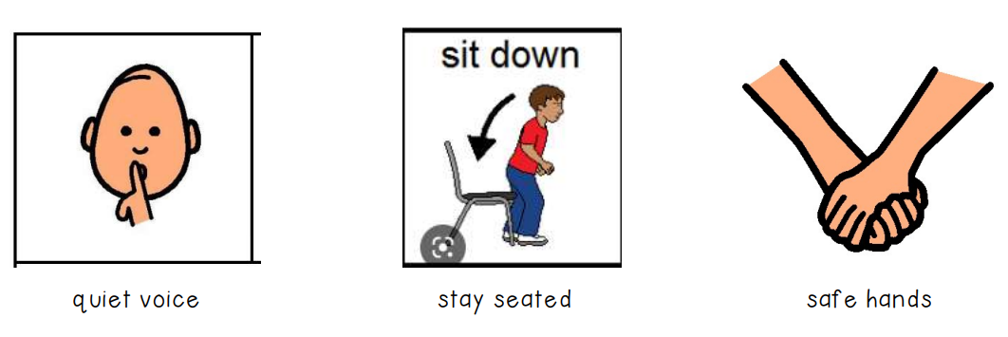
Inclusion in Art
Visual behavior support – reviewed upon entering the art classroom and referenced throughout class.
Rebecca Bertoch, Cheryl Stinson John G. Riley Elementary School
Leon County
Dawn Merrix
Florida State University CARD Center
Tallahassee, FL

Slide 7
Inclusion in Art
Process:
Each table in the art room had 2 visual schedules and 2 sets of routine cards for referencing.
Visual support strategies were explained and modeled for the art teacher and paraprofessionals.
Additional strategies discussed and modeled included: structured wait time, placement of materials, providing choices, first/then language, and use of fidgets or manipulatives.
Rebecca Bertoch, Cheryl Stinson John G. Riley Elementary School
Leon County
Dawn Merrix
Florida State University CARD Center
Tallahassee, FL

Slide 8
Inclusion in Art
Process:
Laminated rectangles with pictures and words were put on each table as a spatial support to show where students place art materials when they are finished using them.
A mini-schedule for the art lesson was developed, created, and implemented to help the students participate in and complete the lesson.
Teachers worked in the art classroom with paraprofessionals to make sure the implementation was done with fidelity.
Rebecca Bertoch, Cheryl Stinson John G. Riley Elementary School
Leon County
Dawn Merrix
Florida State University CARD Center
Tallahassee, FL

Slide 9
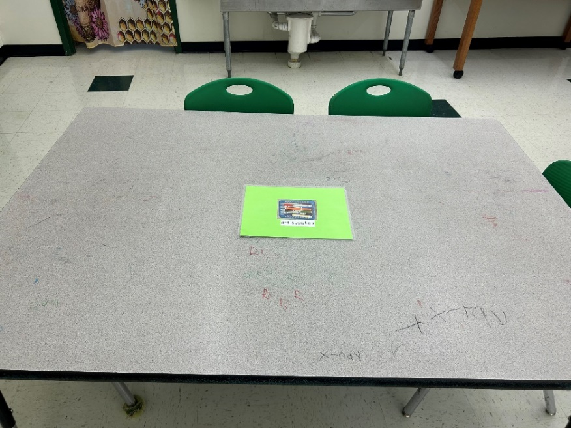
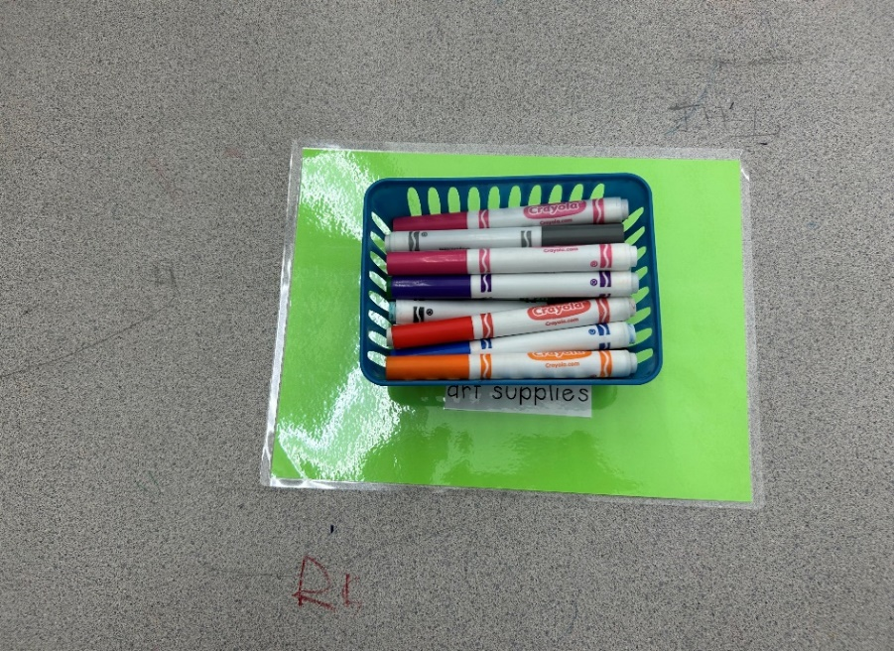
Inclusion in Art
Visual Spatial Support for art materials supports a productive role during the clean-up routine.
Rebecca Bertoch, Cheryl Stinson John G. Riley Elementary School
Leon County
Dawn Merrix
Florida State University CARD Center
Tallahassee, FL

Slide 10
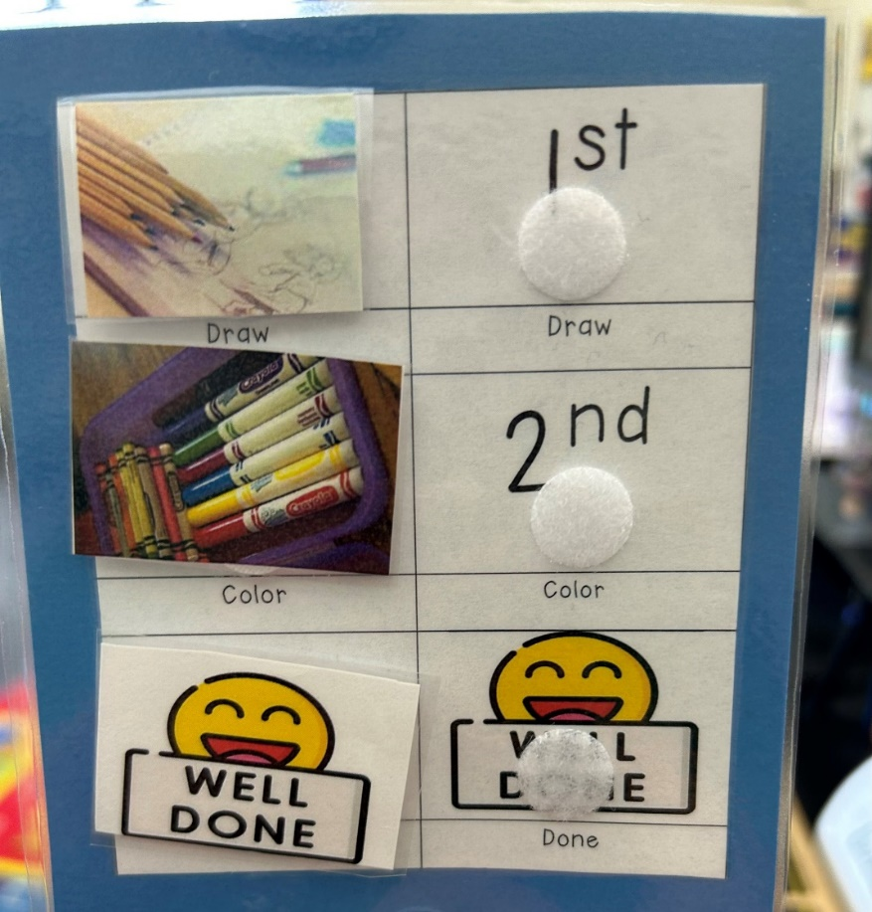
Inclusion in Art
Art Lesson Mini-Schedule
Students move pictures left to right as they complete each task.
Rebecca Bertoch, Cheryl Stinson John G. Riley Elementary School
Leon County
Dawn Merrix
Florida State University CARD Center
Tallahassee, FL

Slide 11
Inclusion in Art
Results:
Students with autism showed less resistance to going to art and were more participatory when visual supports were utilized.
Use of visual supports encouraged active engagement in art class routines and activities.
With continued modeling and support from the art teacher and paraprofessionals, it is believed students will eventually participate in art class with increased independence.
Rebecca Bertoch, Cheryl Stinson John G. Riley Elementary School
Leon County
Dawn Merrix
Florida State University CARD Center
Tallahassee, FL

